Slide 1
Qamar Abbas Student ID: 6217000128 School of computer software Tianjin university china

Slide 2
WATERLEVEL MEASUREMENT
USING ARDUINO AND ULTRASONIC SENSOR

Slide 3
INTRODUCTION
In this project, I am going to make an water level measurement system using the HC-SR04 ultrasonic sensor. The ultrasonic sensor used in this project is used as a distance sensor, it will tell us the distance at which the tank of water will be filled by water. Using this distance value, we will turn the buzzer on or off and the user will know that tank is full.

Slide 4
COMPONENTS
Arduino Nano
HC-SR04 Ultrasonic sensor
Buzzer
Connecting Wires
Breadboard
LED
Water tank

Slide 5
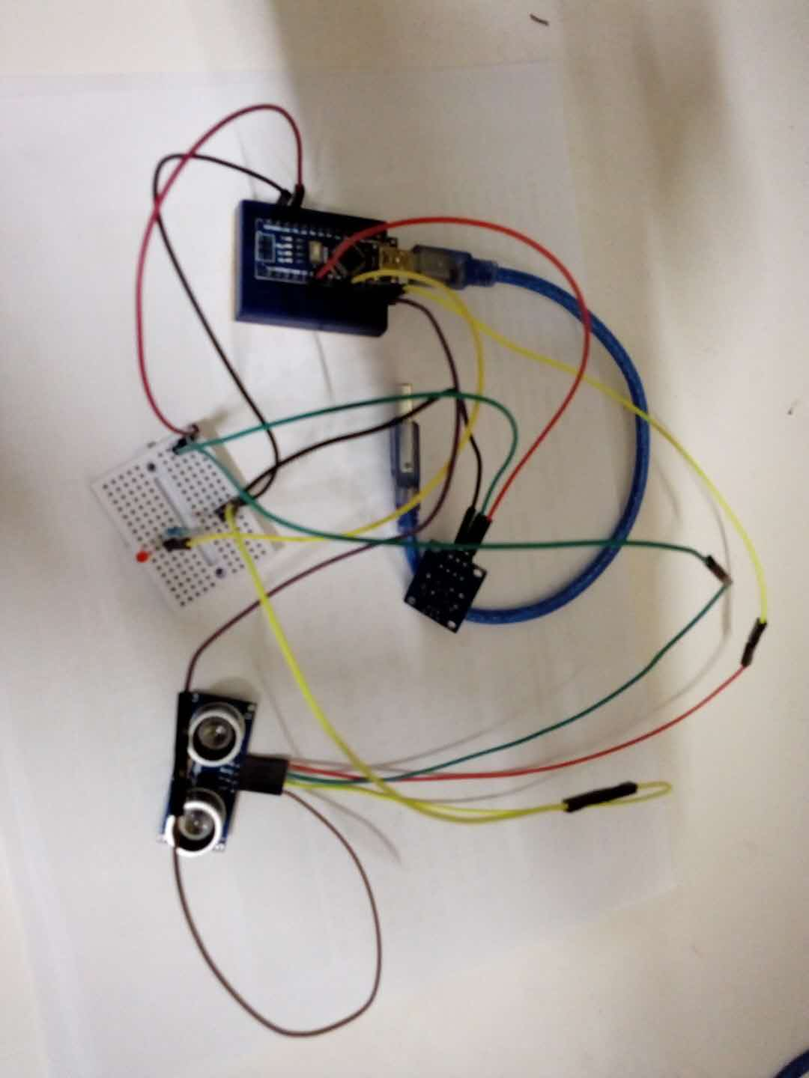
CIRCUIT DIAGRAM

Slide 6
APPLICATIONS
Tank Level Measurements
Chemical Level Measurement
Tank Level Display
Flood Monitoring
Irrigation Management
Remote Water Level Measurement

Slide 7
Thank you

